Slide 1
Rounding integers to significant figures
Estimation and rounding

Slide 2
how to use Oak lessons

Slide 3
I can round integers to a required number of significant figures.

Slide 4
Significant figures are the digits in a number that contribute to the accuracy of the number. The first significant figure is the first non-zero digit.
Round − To change a number into another number that is approximately the same value but is easier to work with. E.g. Round 561 to the nearest 10 is 560.

Slide 5

Rounding integers to significant figures
Using a number line for significant figures
Rounding to a given number of significant figures

Slide 6
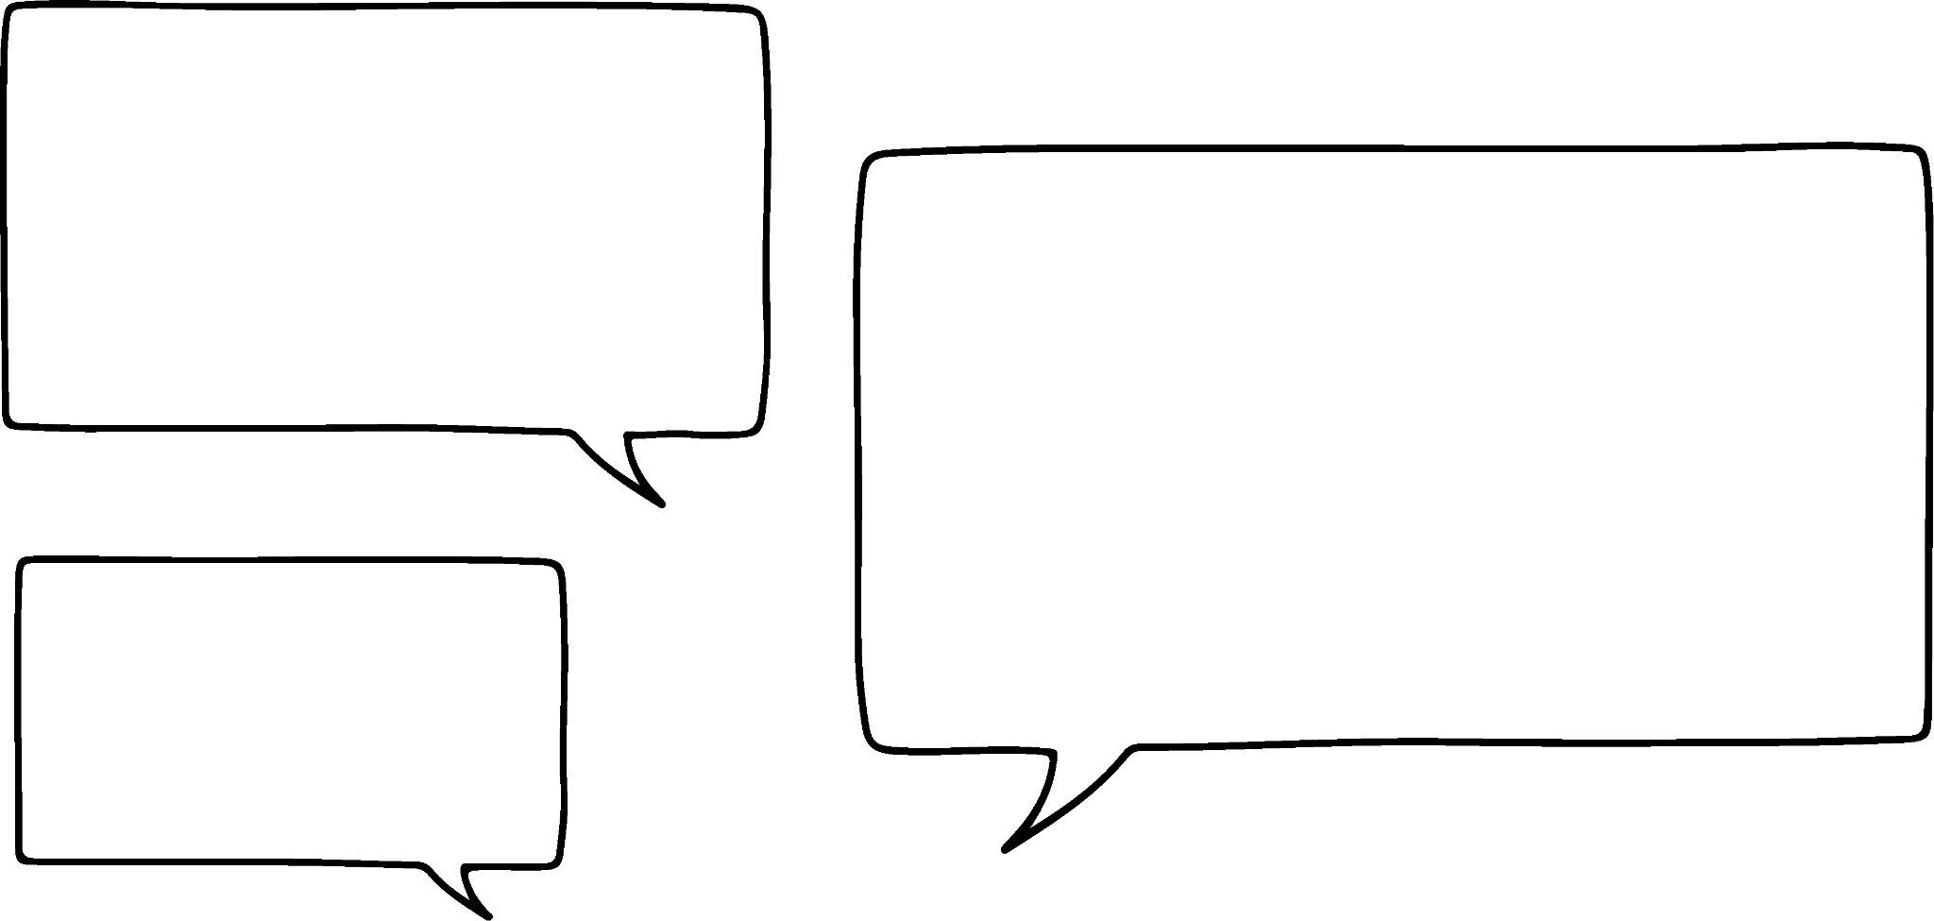
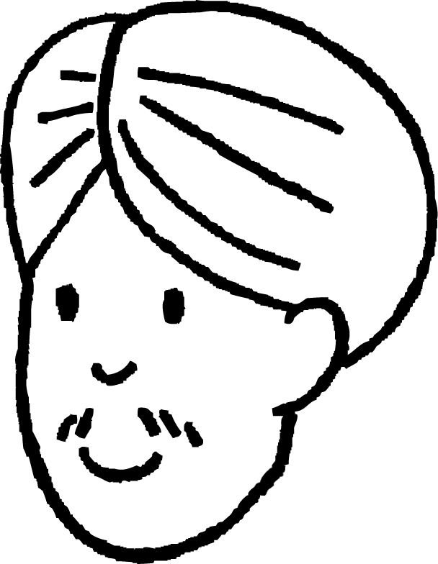
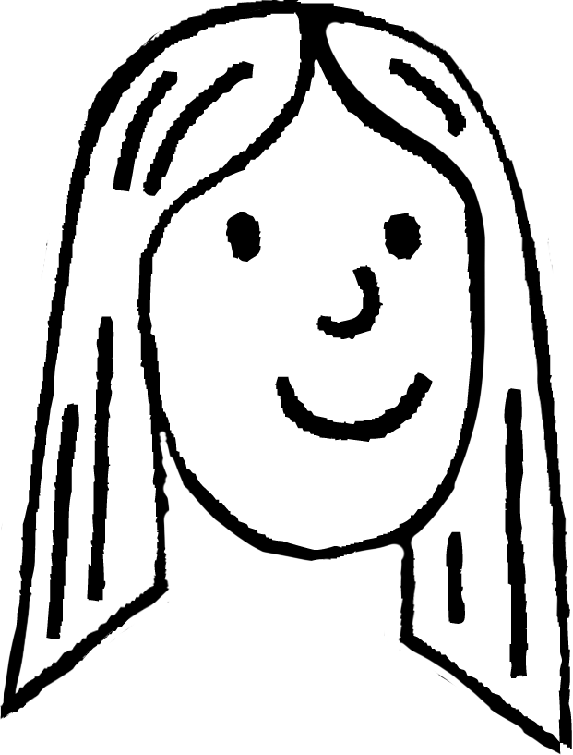
Using a number line for significant figures
Andeep and Laura know how to round to one significant figure.
They are now looking at how to round to more than one significant figure.
They are going to round 34 702 to two significant figures.
That means we are going to round to the nearest thousand then?
I agree Andeep, and the second significant figure is in the thousands column.
I think that the second significant figure is 4 as the first one is the 3.
Yes that is right.
Andeep
Laura

Slide 7
Using a number line for significant figures
The 3rd significant figure of 5678 is …
I would like to practise identifying the correct digit in a number for different significant figures.
Try these Andeep.
Yes, that is right. Well done
I think it is the 7.
Andeep
Laura

Slide 8
Using a number line for significant figures
The 2nd significant figure of 12 345 is …
Well done
Andeep.
I think it is the 2.
Andeep
Laura

Slide 9
Using a number line for significant figures
The 1st significant figure of 67 is …
Right again.
I think it is the 6.
Andeep
Laura

Slide 10
Using a number line for significant figures
The 3rd significant figure of 203 568 is …
Yes it does Andeep. Any digit after the first significant figure is significant.
Andeep, you are definitely ready to start rounding to any number of significant figures.
I’m not so sure on this one. Does the zero count as significant?
So in this one it is the 3.
Andeep
Laura

Slide 11











Using a number line for significant figures
What is 547 to two significant figures?
HMn | TMn | Mn | HTh | TTh | Th | H | T | O | T | H | Th | TTh
 |  |  |  |  |  | 5 | 4 | 7
th
th
th
th
.
.
2nd s.f.
1st s.f.
The second significant figure is in the tens column.
Therefore, we round to the nearest 10.
547
540
545
550
547 rounded to two significant figures is 550

Slide 12
Using a number line for significant figures
All of the numbers below have nine zeros.
How many zeros does each number actually need to preserve the place value of the other digits?
1 zero is needed, trailing zeros after the decimal point are not needed.
50.00000000
50 000 000.00
5.0000000005
5.00050005000
5000.0500000
50000.000005
7 zeros are needed
All 9 zeros are needed
6 zeros are needed
4 zeros are needed
All 9 zeros are needed

Slide 13

Using a number line for significant figures
Which of the following have zeros which are not needed to preserve the place value of other digits?
9000900
99000909.9900
9009.000090
9999000.99

Slide 14
Using a number line for significant figures
What is 23 924 to three significant figures?
HMn | TMn | Mn | HTh | TTh | Th | H | T | O | T | H | Th | TTh
 |  |  |  | 2 | 3 | 9 | 2 | 4
th
th
th
th
.
.
1st s.f.
2nd s.f.
3rd s.f.
The third significant figure is in the hundreds column.
Therefore, we round to the nearest 100.
23 924
23 900
23 950
24 000
23 924 rounded to three significant figures is 23 900

Slide 15
Using a number line for significant figures
What is 60 062.84 to three significant figures?
HMn | TMn | Mn | HTh | TTh | Th | H | T | O | T | H | Th | TTh
 |  |  |  | 6 | 0 | 0 | 6 | 2 | 8 | 4
th
th
th
th
.
.
1st s.f.
2nd s.f.
3rd s.f.
The third significant figure is in the hundreds column.
Therefore, we round to the nearest 100.
60 062.84
60 000
60 050
60 100
60 062.84 rounded to three significant figures is 60 100

Slide 16
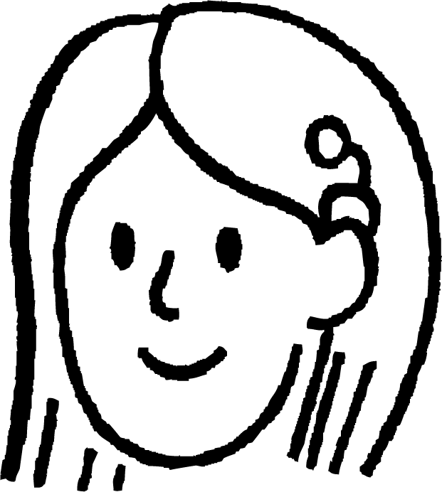
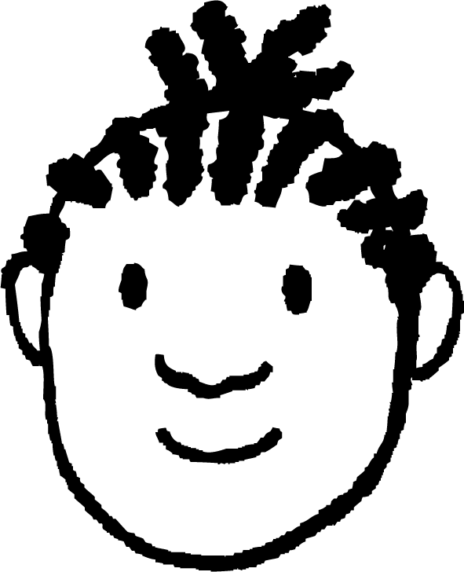
Using a number line for significant figures
Whose answer is correct?
Round 7 003 729 to 4 significant figures.
The 4th s.f. is 2, I look to the right and round up as it is a 9.
The answer is
7 003 730.
The 4th s.f. is 3, I look to the right and round up as it is a 7.
The answer is
7 004 000.
Jacob is correct. Sofia has not counted the zeros in the hundred thousand and ten thousand columns as significant figures.
Jacob
Sofia

Slide 17
Using a number line for significant figures
1) Complete these sentences:
is the 3rd significant figure of 39 271
is the 2nd significant figure of 1842
is the 1st significant figure of 390 482
is the 4th significant figure of 13 456
is the 2nd significant figure of 2035
is the 3rd significant figure of 507 836
is the 5th significant figure of 1 007 832

Slide 18
Using a number line for significant figures
2) Match the following to the correctly rounded figure:
87 995
88 000 (3 s.f.)
86 952
88 000 (2 s.f.)
88 145
87 000 (2 s.f.)
87 492
87 000 (3 s.f.)

Slide 19
Using a number line for significant figures
3) Round each of the following to the number of significant figures given in the brackets.
a) 1672 = (2 s.f.)
b) 1672 = (3 s.f.)
c) 23 937 = (2 s.f.)
d) 23 937 = (3 s.f.)
e) 175 302 = (1 s.f.)
f) 175 302 = (4 s.f.)
g) 407 = (1 s.f.)
h) 407 = (2 s.f.)
i) 50 376 = (2 s.f.)
j) 50 376 = (3 s.f.)
k) 730 095 = (4 s.f.)
l) 730 095 = (5 s.f.)

Slide 20
Using a number line for significant figures
1) Complete these sentences:
2 is the 3rd significant figure of 39 271
8 is the 2nd significant figure of 1842
3 is the 1st significant figure of 390 482
5 is the 4th significant figure of 13 456
0 is the 2nd significant figure of 2035
7 is the 3rd significant figure of 507 836
8 is the 5th significant figure of 1 007 832

Slide 21
Using a number line for significant figures
2) Match the following to the correctly rounded figure:
87 995
88 000 (3 s.f.)
86 952
88 000 (2 s.f.)
88 145
87 000 (2 s.f.)
87 492
87 000 (3 s.f.)

Slide 22
Using a number line for significant figures
3) Round each of the following to the number of significant figures given in the brackets.
a) 1672 = 1700 (2 s.f.)
b) 1672 = 1670 (3 s.f.)
c) 23 937 = 24 000 (2 s.f.)
d) 23 937 = 23 900 (3 s.f.)
e) 175 302 = 200 000 (1 s.f.)
f) 175 302 = 175 300(4 s.f.)
g) 407 = 400 (1 s.f.)
h) 407 = 410 (2 s.f.)
i) 50 376 = 50 000 (2 s.f.)
j) 50 376 = 50 400 (3 s.f.)
k) 730 095 = 730 100 (4 s.f.)
l) 730 095 = 730 100 (5 s.f.)

Slide 23
Rounding integers to significant figures
Using a number line for significant figures
Rounding to a given number of significant figures

Slide 24
Rounding to a given number of significant figures
Round 5784 to three significant figures.
HMn | TMn | Mn | HTh | TTh | Th | H | T | O | T | H | Th | TTh | HTh | Mh
 |  |  |  |  | 5 | 7 | 8 | 4
.
th
th
th
th
th
th
.
1st s.f.
2nd s.f.
3rd s.f.
4 is less than 5
The third significant figure is in the tens column.
Therefore, we round to the nearest 10.
Therefore, the digit in the tens column stays the same.
5784 = 5780 (3 s.f.)
Ensure that a placeholder is used in the ones column to maintain the place value of the 8.

Slide 25
Rounding to a given number of significant figures
Round 145 508 to two significant figures.
HMn | TMn | Mn | HTh | TTh | Th | H | T | O | T | H | Th | TTh | HTh | Mh
 |  |  | 1 | 4 | 5 | 5 | 0 | 8
.
th
th
th
th
th
th
.
1st s.f.
2nd s.f.
5 is greater than or equal to 5
The second significant figure is in the ten thousands column.
Therefore, we round to the nearest 10 000.
Therefore, we increase the digit in the 10 000 column by 1
145 508 = 150 000 (2 s.f.)
Ensure that the place holders are used in the thousands, hundreds, tens and ones columns to maintain the place value of the other digits.

Slide 26
Rounding to a given number of significant figures
Round 30 559 to three significant figures.
HMn | TMn | Mn | HTh | TTh | Th | H | T | O | T | H | Th | TTh | HTh | Mh
 |  |  |  | 3 | 0 | 5 | 5 | 9
.
th
th
th
th
th
th
.
1st s.f.
2nd s.f.
3rd s.f.
exactly halfway
The third significant figure is in the hundreds column.
Therefore, we round to the nearest 100.
Therefore, we increase the digit in the 100 column by 1
30 559 = 30 600 (3 s.f.)
Ensure that the place holders are used in the tens and ones columns to maintain the place value of the other digits.

Slide 27
Rounding to a given number of significant figures
Round 50 608 to two significant figures.
1 s.f.
2 s.f.
TTh | Th | H | T | O
5 | 0 | 6 | 0 | 8
The digit in this column is greater than 5.
Therefore we will round up.
50 608 = 51 000 (2 s.f.)

Slide 28
Rounding to a given number of significant figures
Round 50 608 to two significant figures.
Round 46 327 to three significant figures.
2 s.f.
1 s.f.
2 s.f.
3 s.f.
TTh | Th | H | T | O
5 | 0 | 6 | 0 | 8
TTh | Th | H | T | O
4 | 6 | 3 | 2 | 7
The digit in this column is greater than 5.
The digit in this column is less than 5.
Therefore we will round up.
50 608 = 51 000 (2 s.f.)
Therefore we will round down.
46 327 = 46 300 (3 s.f.)

Slide 29
Rounding to a given number of significant figures
Round each number to the given number of significant figures in brackets and complete the cross number puzzle.
1
Across
1) 9324 (1 s.f.)
2) 34 605 (3 s.f.)
5) 8408 (3 s.f.)
6) 32 047 (3 s.f.)
7) 45 452 (3 s.f.)
10) 365.92 (2 s.f.)
12) 1 530 204 (1 s.f.)
Down
1) 9078 (3 s.f.)
2) 250.02 (1 s.f.)
3) 693 638 (5 s.f.)
4) 7118 (3 s.f.)
5) 7950 (2 s.f.)
8) 565.45 (2 s.f.)
9) 499.53 (3 s.f.)
11) 78.498 (2 s.f.)
2
3
4
5
6
7
8
9
10
11

Slide 30
Rounding to a given number of significant figures
Round each number to the given number of significant figures in brackets and complete the cross number puzzle.
1
 |  |  |  | 9 | 0 | 0 | 0
3 | 4 | 6 | 0 | 0 |  |  |  | 7
0 |  | 9 |  | 8 |  | 8 | 4 | 1 | 0
0 |  | 3 | 2 | 0 | 0 | 0 |  | 2
 |  | 6 |  |  |  | 0 |  | 0
 |  | 4 | 5 | 5 | 0 | 0 |  |  | 5
3 | 7 | 0 |  | 7 |  |  |  |  | 0
 | 8 |  | 2 | 0 | 0 | 0 | 0 | 0 | 0
Across
1) 9324 (1 s.f.)
2) 34 605 (3 s.f.)
5) 8408 (3 s.f.)
6) 32 047 (3 s.f.)
7) 45 452 (3 s.f.)
10) 365.92 (2 s.f.)
12) 1 530 204 (1 s.f.)
Down
1) 9078 (3 s.f.)
2) 250.02 (1 s.f.)
3) 693 638 (5 s.f.)
4) 7118 (3 s.f.)
5) 7950 (2 s.f.)
8) 565.45 (2 s.f.)
9) 499.53 (3 s.f.)
11) 78.498 (2 s.f.)
2
3
4
5
6
7
8
9
10
11
12

Slide 31
Rounding integers to significant figures
Rounding to significant figures is the same as rounding to the nearest 10, 100, 1000, etc.
The first significant figure is the first non-zero digit.
Zeros between other significant figures are significant and should be counted.
E.g. 500.500005 500.5005000
Number lines and place value grids can be used to round to significant figures.
all significant
not significant
significant

Slide 32

© Oak National Academy 2024.
Produced in partnership with Mathematics in Education and Industry.
Licensed on the Open Government Licence v3.0, except where otherwise stated. See Oak terms and conditions.

